Slide 1
Modernizing Canada's Approach toP3s
Policy Brief for the [Government of XX]
Presented by: [Name, Title, Contact]

Slide 2
AGENDA/CONTENTS
Context
Key Market Challenges
Policy Recommendations
What does this mean for [Government XX]?

Slide 3
Context
The P3 Opportunity

Slide 4
Shifting Landscape of Canadian Infrastructure Funding
The P3 Opportunity: A Renewed Path Forward
Public-Private Partnerships (P3s): A Tried and Tested Solution
Concrete and Actionable Solutions: Includes delivery models such as fixed-price, lump sum, Progressive models, alternative financing, concessions, and pension fund investments.
Relevance for Large Projects: Essential for capital-intensive projects in the current economic climate.
Harness the discipline and expertise of private: this is Canada’s moment to redefine how it funds and procures major infrastructure projects, ensuring our assets meet immediate needs and offer sustained, long-term value to our communities.
Provinces and municipalities can no longer depend on traditional government grants and contributions: With rising deficits and ballooning government deficits reliance on federal programs like the Investing in Canada Infrastructure Program is diminishing.
Need for Alternative Solutions: Alternative delivery models must be explored to address infrastructure needs and deliver value for taxpayers.

Slide 5
Why P3s
Historical Context: The Rise of P3s
During the 1990s, governments grappling with significant debt and substantial infrastructure challenges like cost overruns and project delays.
The use of performance-based contracts, which focus on what an asset needs to deliver rather than on how to build it, and the inclusion of private capital spurred management discipline and project innovation and helped attract a wider range of private sector expertise.
Key Benefits of P3s
Successful Canadian P3s rely on strong partnerships, appropriate risk allocation, and shared benefits.
P3s present a tried and tested solution to safeguard taxpayers' dollars and ensure value for money (VfM) throughout the entire life cycle of an asset.
Help ensure jurisdictions are capturing maintenance, life cycle renewal, and operations costs from the onset.
DBFOM and DBFM models as viable and preferred options for P3s in Canada when used in the right context to ensure maximum value for taxpayer
All Canadian P3 projects share these four key attributes:
Allocate the appropriate risk transfer to the party best suited to manage it,
Consider the whole life cycle of the asset,
Drive innovation and efficiencies, and
Leverage private capital and expertise.

Slide 6
02
Key Market Challenges
Modernizing P3s to Meet Community Needs

Slide 7
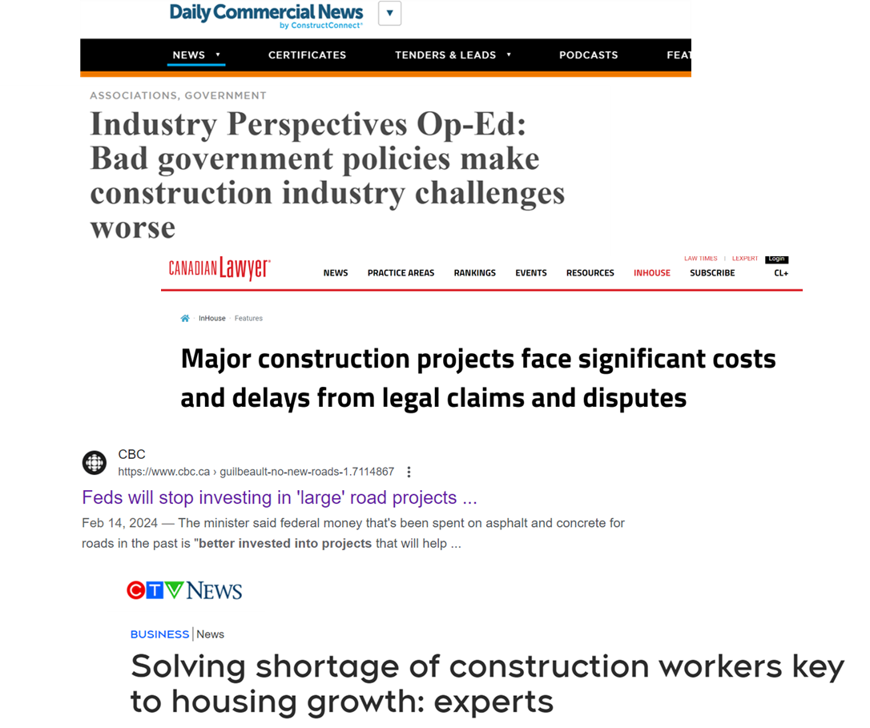
How do we deliver resilient and affordable infrastructure in the face of climate change, a booming population, and decreasing government revenues?
Navigating Complex Issues:
Infrastructure projects across the country – regardless of procurement model – are struggling with the same challenges.
Competition, Labour and Cost Challenges:
Shortage of skilled labour and difficulties in costing volatile commodity prices.
The exit of experienced national and international players from the market, impacting government's ability to attract significant competition for projects.
These challenges affect timely and budget-compliant project delivery across all procurement models.
Lingering effects of the pandemic and rising litigation among project partners.

Slide 8
Specific Challenge for P3s
Risk Allocation Concerns: Concerns over unreasonable risk transfer to the private sector (e.g., utility risk, scheduling risk, permitting issues).
Slowing Pipeline and Market Losses: Decline in P3 project pipeline and loss of key markets (e.g., British Columbia)
Project Cancellations: Cancellations occurring late in the procurement process create a “chill” in the market.
Saturation and Mega Projects: Increase in large projects ($500 million+) and growing number of mega projects ($1 billion+).
Price-Based Bidding: Competition driven by price alone, rather than valuing quality and innovation in RFPs.
Unrealistic Cost Estimates: Perceptions of projects being over budget due to outdated or inaccurate cost estimates. Challenges include inexperienced estimating, insufficient classes of estimates, outdated estimates, and unaccounted commercial/contract risks.
Short-Term Contracts: Move away from long-term contracts (no operations or maintenance) undermines the value of linking asset performance with its design and construction.

Slide 9
Modernizing the Future of Canadian P3 :
The Council’s Call to Action
Need for Adaptation: Addressing lingering and emerging infrastructure challenges requires adapting and evolving practices.
Recommendations for Progress: The Council, in collaboration with public and private sector members, has developed eight key recommendations to guide policymakers and decision-makers. These recommendations aim to create a more responsive, agile, and competitive infrastructure market, delivering greater value for Canadians.

Slide 10
8 KEY RECOMMENDATIONS AT A GLANCE
Using private capital to stretch those scarce tax dollars further by bringing enhanced oversight of the investors since they have “skin in the game” to deliver on time and on budget.
Thinking long term when procuring infrastructure to ensure there is protected funding for ongoing maintenance, life cycle renewal and operation costs for decades to come.
Everyone wins, especially Canadians, when the public and private sectors work together. That's why a nimbler, less rigid approach is needed when it comes to risk allocation.
Governments need to see themselves not merely as contractors or service providers but as “industrial owners” with a vested interest in a project's long-term success. They must actively oversee P3 contracts and provide centralized support to P3 contract management to minimize disputes and enhance transparency.
Governments should investigate using a Progressive P3 (DBFM/DBFOM) approach for exceptionally large and/or complex projects where earlier contractor involvement could provide significant benefit for Canadian communities.
Where possible, governments should consider breaking large, projects (exceeding $500 million) into phases to attract greater competition, produce greater market tension and greater certainty in execution, and cost savings for taxpayers.
In the spirit of increasing transparency, rebuilding trust and delivering top quality infrastructure for Canadians, governments should work with each other to share best practices and establish new cross-Canada standards.
Governments should evolve procurement approaches to ensure early engagement with private-sector proponents and foster a solutions-oriented procurement environment.

Slide 11
03
Policy Recommendations
The Path Forward

Slide 12
1. Using private capital to stretch those scarce tax dollars further by bringing enhanced oversight of the investors since they have “skin in the game” to deliver on time and on budget.
Leveraging Private Capital: In the face of shrinking revenues and public resistance to higher taxes, using private capital can stretch limited public funds further. Investors’ “skin in the game” enhances oversight, ensuring projects are delivered on time and on budget.
Encouraging P3 Exploration: The Council urges all levels of Canadian government to explore and assess P3 and alternative finance options for complex, large-scale infrastructure projects.
Enhanced Accountability: Private capital in P3s enhances accountability and ensures long-term maintenance and lifecycle renewal of assets. Research supports that the extra financing cost of P3s is justified for the risk transfer, proving valuable for maximizing taxpayer dollars.

Slide 13
2. Thinking long term when procuring infrastructure to ensure there is protected funding for ongoing maintenance, life cycle renewal and operation costs for decades to come.
Proven P3 Models: Canada’s DBFM and DBFOM models have a successful track record, integrating long-term maintenance and lifecycle investment across various asset classes including highways, schools, and hospitals.
Expanding P3 Application: There are opportunities to apply P3s to new areas such as energy projects, bundling projects for community-enabling infrastructure delivery and long-term asset management (e.g., water/wastewater), and Indigenous community infrastructure, and addressing the $425 billion infrastructure gap.
Adapting to Market Needs: The Council supports adapting P3 models to current market conditions and new asset classes, while exploring revenue-generating concessions and Progressive models, and asset monetization and recycling, used internationally, to create additional revenue-generating tools to deliver greater value for money for public infrastructure.

Slide 14
3. Everyone wins, especially Canadians, when the public and private sectors work together. That's why a nimbler, less rigid approach is needed when it comes to risk allocation.
Effective Risk Allocation: Risk should be managed by the partner best equipped to handle it, considering market conditions. Proper risk allocation protects taxpayers and improves project outcomes.
Key Factors for Success:
Realistic pricing reflecting current market conditions
Selection of the correct procurement model
Competitive procurement processes
Clear, tailored risk expectations for different asset classes
Enhancing Risk Management:
Adopt a “First Principles” approach for structuring contracts and risk management, leveraging insights from recent guides.
Implement robust monitoring systems and dynamic risk registers for continuous assessment and adjustment.
Consider Progressive procurement models for further exploration and improvement in risk management.

Slide 15
4. Governments need to see themselves not merely as contractors or service providers but as “industrial owners” with a vested interest in a project's long-term success. They must actively oversee P3 contracts and provide centralized support to P3 contract management to minimize disputes and enhance transparency.
Active Oversight: Public authorities must oversee P3 contracts closely, ensuring performance and compliance through regular audits.
Fostering Collaboration: Owners and private sector partners should work together to resolve issues within the project's framework, avoiding disputes that damage the P3 model's integrity.
Centralized Support & Best Practices:
Government should provide centralized support for contract management to ensure consistency and reduce disputes.
Consider adopting practices from the UK's White Fraiser Report, such as the "industrial owner" perspective, where private sector partners view themselves as integral to the project's long-term success.

Slide 16
5. Governments should investigate using a Progressive P3 (DBFM/DBFOM) approach for exceptionally large and/or complex projects where earlier contractor involvement could provide significant benefit for Canadian communities.
Why Go Progressive?
Early Collaboration: Engaging both public and private sectors early helps mitigate risks, provide realistic pricing, and reduce transaction costs, overruns, and delays.
Market-Viable Solutions: Progressive approaches prioritize economically feasible projects and protect the private sector from excessive risk. It involves selecting a partner early to collaboratively define and de-risk the project.
Core Attributes of Progressive P3s:
Focus on the whole life cycle of the asset (including operations and/or maintenance) early in the planning phase.
Incorporate private capital investment and expertise.

Slide 17
6. Where possible, governments should consider breaking large, projects (exceeding $500 million) into phases to attract greater competition, produce greater market tension and greater certainty in execution, and cost savings for taxpayers.
Problem Solving for Competition: The Canadian Boom in Mega Projects & Other Complex Projects
Attracting New Bidders: Potential Benefits of Progressive P3s
Address risk transfer issues
Regain interest from companies that exited the market
Competition Challenges: Limitations of Progressive P3s
Issues with large-scale social projects
Contractor and subcontractor capacity concerns
Solution? Refocusing on Project Scalability:
Enhance risk and logistics management
Ensure effective competition and execution
Aim for improved pricing efficiency and certainty

Slide 18
7. In the spirit of increasing transparency, rebuilding trust and delivering top quality infrastructure for Canadians, governments should work with each other to share best practices and establish new cross-Canada standards.
Modernizing Value-for-Money (VfM) Analysis for P3s
Current Practice:
VfM analysis has been the cornerstone for P3 decision-making in Canada, factoring in project risk, scheduling, budget, market realities, and capacity.
Need for Evolution:
As new P3 approaches emerge, current VfM methodologies need updating to reflect these changes and address recent shifts in the model.
Solution?
Collaborate across jurisdictions to update P3 documents and procurement tools, incorporating an industry-wide approach while considering regional differences. The Council offers to facilitate this process to enhance understanding and transparency.

Slide 19
8. Governments should evolve procurement approaches to ensure early engagement with private-sector proponents and foster a solutions-oriented procurement environment.
Early Private Sector Engagement: Encourage industry feedback early in planning to refine project scope and pricing, reducing risks and avoiding costly re-procurement. Ensure collaboration includes government project teams.
Review Evaluation Criteria: Update criteria to attract new and former market participants. Focus on outcomes over outputs and avoid cost-driven 'race to the bottom' mentality.
Embrace Transparency: Increase transparency in project details, contracts, and plans to attract more bids and improve results. Flexibility and clear communication are key.
Market Reflective Cost Estimates: Use accurate, current cost estimates to build trust and avoid issues. Employ robust public sector estimation tools reflecting market realities and ensuring proper cost capture.
Mitigate Market Risks: Refresh risk management strategies with insights from AIAI. Develop dynamic management tools for ongoing risk assessment and clear cost-sharing rules. Implement effective dispute resolution and collaboration processes.

Slide 20
03
What does this mean for the [Government of XX]
{

Slide 21
What does this mean for [insert name of jurisdiction]?
Need a slide or two tailored to the jurisdiction...
Current Challenges…
How P3s can help solve problem X,Y,Z…
Screen project pipeline for opportunities...

Slide 22
NAME, TITLE, CONTACT
The Canadian Council for Public-Private Partnerships
P.O. Box 565, Stn. Adelaide
Toronto, Ontario, M5C 2J6, Canada
Tel: +1.416.861.0500
Website: pppcouncil.ca

